Slide 1
CS 179: GPU Computing
Recitation 1 - 4/1/16

Slide 2
Recap
Device (GPU) runs CUDA kernel defined in .cu and .cuh files
C++ code with a few extensions
Compiled with proprietary NVCC compiler
Kernel defines the behavior of each GPU thread
Program control flow managed by host (CPU)
Uses CUDA API calls to allocate GPU memory, and copy input data from host RAM to device RAM
In charge of calling kernel - (almost) like any other function
Must also copy output data back from device to host
Executable is ultimately C++ program compiled by G++
Doesn’t treat object files (.o) produced by NVCC any differently

Slide 3
Recap
GPU hardware abstraction consists of a grid of blocks of threads
Grid and blocks can have up to three dimensions
Each block assigned to an independent streaming multiprocessor (SM)
SM divides blocks into warps of 32 threads
All threads in a warp execute the same instruction concurrently
Warp divergence occurs when threads must wait to execute different instructions
GPUs are slow - waiting adds up fast!
Parallelizable problems can be broken into independent components
Want to assign one thread per “thing that needs to get done”
Even better if threads in a warp don’t diverge

Slide 4
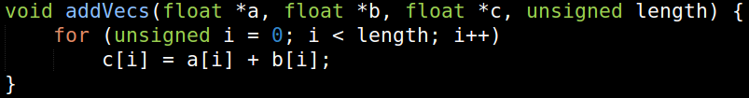
Parallelizable Problems
Most obvious example is adding two linear arrays
CPU code:
Need to allocate a, b, c and populate a, b beforehand
(But you should know how to do that)
Why is this parallelizable?
For i ≠ j, operations for c[i] and c[j] don’t have any interdependence
Could happen in any order
Thus we can do them all at the same time (!) with the right hardware

Slide 5
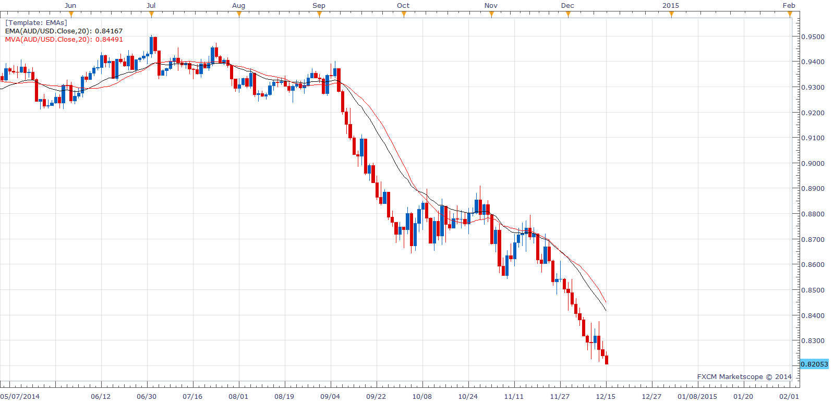
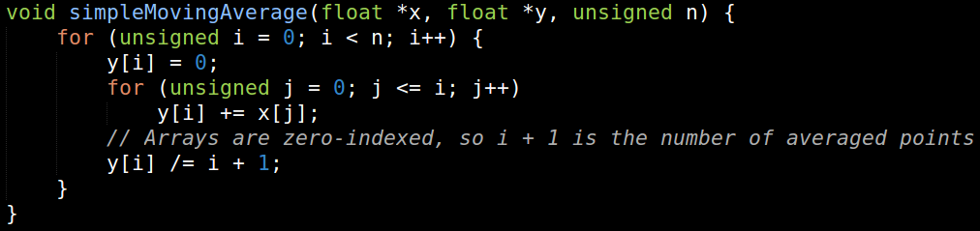
Non-Parallelizable Problems
Potentially harder to recognize
Consider computing a moving average
Input array x of n data points
Output array y of n averages
Two well-known options:
Simple
Exponential
Simple method just weights all data points so far equally
CPU code:
Parallelizable? Yes!
y[i] values separate

Slide 6
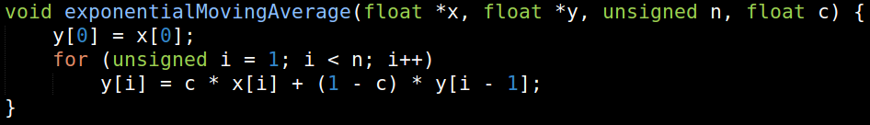
Non-Parallelizable Problems
What about an exponential moving average?
Uses a recurrence relation to decay point weight by a factor of 0 < 1 - c < 1
Specifically, y[i] = c · x[i] + (1 - c) · y[i - 1]
Thus y[n] = c · (x[n] + (1 - c) · x[n - 1] + … + (1 - c)^{n - 1} · x[1]) + (1 - c)^{n} · x[0]
CPU code:
Parallelizable? Nope
Need to know y[i] before calculating y[i + 1]

Slide 7
What Have We Learned?
Not all problems are parallelizable
Even similar-looking ones
Harnessing the GPU’s power requires algorithms whose computations can be done at the same time
“Parallel execution”
Opposite would be “serial execution,” CPU-style
Output elements should probably not rely on one another
Would require multiple kernel calls to compute otherwise
Different blocks of threads can’t wait for each other, more on that later in the course
In addition to all the extra instructions, there’s a lot of overhead

Slide 8
Assignment 1: Small-Kernel Convolution
First assignment involves manipulating an input signal
In particular, a WAV (.wav) audio file
We provide an example to test with
Using audio will require libsndfile
Installation instructions included in assignment
Code also includes an option to use random data instead
C++ and CUDA files provided, your job to fill in TODOs
Code already includes CPU implementation of desired algorithm
Your job is to write the equivalent CUDA kernel to parallelize it
You’re also in charge of memory allocation and host-device data transfers
Conceptually straightforward, goal is familiarity with integrating CUDA into C++

Slide 9
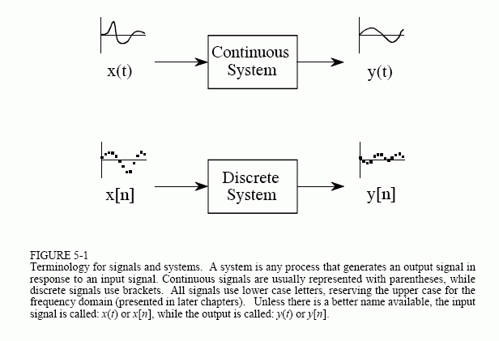
Some Background on Signals
A system takes input signal(s), produces output signal(s)
A signal can be a continuous or discrete stream of data
Typically characterized by amplitude
E.g. continuous acoustic input to a microphone
A continuous signal can also be discretized
Simply sample it at discrete intervals
Ideally periodic in nature
E.g. voltage waveform microphone output
We will consider discrete signals
Assignment uses two-channel audio

Slide 10
Linear Systems
Suppose some system takes input signal x_{i}[n] and produces output signal y_{i}[n]
We denote this as x_{i}[n] → y_{i}[n]
If the system is linear, then for constants a, b we have:
a · x₁[n] + b · x₂[n] → a · y₁[n] + b · y₂[n]
Now suppose we want to pick out a single point in the signal
We can do this with a delta function, 𝛅
If we treat it as a discrete signal, we can define it as:
𝛅 [n - k] = 1 if n = k, 𝛅 [n - k] = 0 if n ≠ k
“Zero everywhere with a spike at k”
This definition means that x[k] = x[n] · 𝛅 [n - k]
Note: I was wrong about this in recitation. We use the delta function to pick out the value of signal x[n] at constant point k.

Slide 11
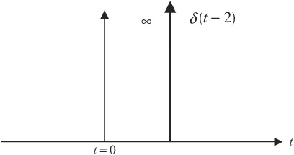
Linear Systems
Next we can define a system’s response to 𝛅 [n - k] as h_{k}[n]
I.e. 𝛅 [n - k] → h_{k}[n]
From linearity we then have x[n] · 𝛅 [n - k] → x[n] · h_{k}[n]
x[n] is the input signal, 𝛅 [n - k] is the delta function signal
Note: I was wrong about this in recitation; see the previous slide for details.
Response at time k defined by response to delta function

Slide 12
Time-Invariance
If a system is time-invariant, then it will satisfy:
x[n] → y[n] ⇒ x[n + m] → y[n + m] for integer m
Thus given 𝛅 [n - k] → h_{k}[n] and 𝛅 [n - l] → h_{l}[n], we can say that h_{k}[n] and h_{l}[n] are “time-shifted” versions of each other
Instead of a new response h_{k}[n] for each k, we can define h[n] such that 𝛅 [n] → h[n], and shift h with k such that 𝛅 [n - k] → h[n - k]
By linearity, we then have x[n] · 𝛅 [n - k] → x[n] · h_{k}[n]
This lets us rewrite the system’s response x[n] → y[n]:
x[n] = Σ x[k] · 𝛅 [n - k] → Σ x[k] · h_{k}[n - k] = x[k] · h_{k}[n] = y[n]
Output must be equivalent to y[n] because x[n] → y[n]
Note: sum is over all k.

Slide 13
What Have We Learned?
Linear time-invariant systems have some very convenient properties
Most importantly, they can be characterized entirely by h[n]
This allows y[n] to be written entirely in terms of the input samples x[k] and the delta function response h[n]
Remember:
y[n] = Σ x[k] · h_{k}[n - k]
x[n] is the input signal to our system
y[n] is the output signal, or “impulse response” from our system
𝛅 [n] is the delta function signal
h[n] is the impulse response from our system for 𝛅 [n]

Slide 14
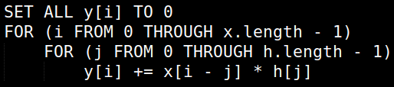
Putting It All Together
Assignment asks you to accelerate convolution of an input signal
E.g. input x[0..99], system with h[0..3] delta function response
For finite-duration h such as this, computable with y[n] = Σ x[k] · h[n - k]
y[50] computation, for example, would be:
y[50] = x[47] · h[3] + x[48] · h[2] + x[49] · h[1] + x[50] · h[0]
All other h terms are 0
Here y[50] etc. refer to the signal at that point
This sum is parallelizable
Pseudocode:

Slide 15
Assignment Details
All you need to worry about is the kernel and memory operations
We provide the skeleton and some useful tools
CPU implementation - reference this for your GPU version
Error checking code for your output
Delta function response h[n] (default is Gaussian impulse response)
Note: I was wrong in the recitation, saying that h[n] is the response to any function we wish to convolve. Rather, the system is defined such that its response to the delta function is the signal we to convolve.
This derivation is a discrete-time version of https://en.wikipedia.org/wiki/LTI_system_theory#Impulse_response_and_convolution. Looking at this will help distinguish when we refer to the signal as a function and when we refer to a specific point in it.

Slide 16
Assignment Details
Code can be compiled in one of two modes
Normal mode (AUDIO_ON defined to be 0)
Generates random x[n]
Can test performance on various input lengths
Can run repeated trials by increasing number of channels
Audio mode (AUDIO_ON defined to be 1)
Reads x[n] from input WAV file
Generates output WAV from y[n]
Gaussian h[n] is an (imperfect) low-pass filter - high frequencies should be attenuated

Slide 17
Debugging Tips
printf() can be useful, but gets messy if all threads print
Better to only print from certain threads, though your kernel will diverge
If you want to check your kernel’s output, copy it back to the host
More manageable than printing from the kernel and you can write normal C++ to inspect the data
Use the gpuErrchk() macro to check CUDA API calls for errors
Example usage: gpuErrchk(cudaMalloc(&dev_in, length * sizeof (int)));
Prints error info to stderr and exits
Use small convolution test cases before trying large arrays or the test WAV
E.g. 5-element x[n], 3-element h[n]

Slide 18
Any Questions?

